Slide 1

Analysis of the Customer Survey Dataset
Key Questions:
Who are our customers?
What is their financial status?
Can we categorize them into group for future communication?
Are we making happy customers? What are the levels of satisfaction?
Is there a business model that the customers prefer?
How many return customer( happy customer) come back to shop?
Do we have a loyal customer base that we can count for sustainability?
Can we make crucial business and marketing decisions from the analysis?
What are the limits of the dataset ?
How can we use the findings for future analysis ?

Slide 2
Overview of the dataset
Customer
Feedback
Service satisfaction
Selection satisfaction
Personal
Information
Cust ID
Store
Activity
Store transaction
Online Spend
Age
Credit Score
Distance to Store
Email
Store Spend
Online visit
Online transaction
Dataset
*Graphics show dataset distribution by defined categories not original column names

Slide 3
Customer Categorization
Prospects: Visited but no transaction
(Potential target)
2. Regular : Spent between $1-$50
(New/average customer)
3. Premium : Spent between $250 –$ 500
(Makes the largest percentage of our customers)
4. VIP : Spent between $250-500
(Key targets for specifically designed promotions and offers)
5. VVIP : Spent over $500
(Prime targets for specifically designed promotions and offers)
*Pie chart showcase the distribution of total 1000 customers

Slide 4
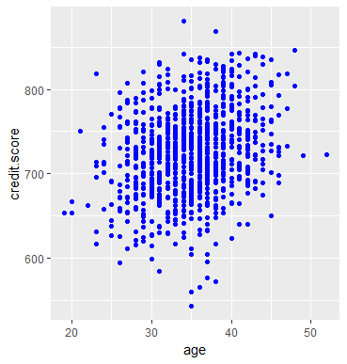
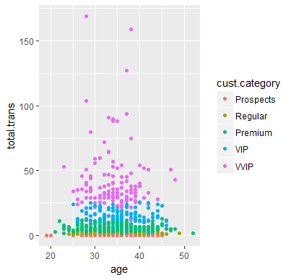
Age and Financial Stability ?
Average age :35 years
Most customer belong to 25-45 years group
Average Credit Score: 726
Most 25-45 years old have good to excellent score
Age Range: (18-55 years)
Credit Score Range: 600-950

Slide 5
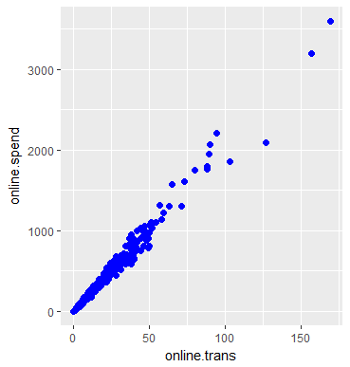
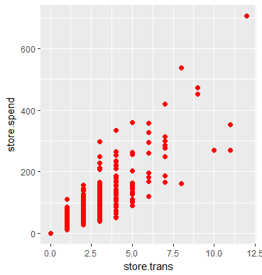
Online and Store Purchase Distribution
Online
Store
22% of our customer shop at store
Average no. of transaction: 1 (range: 0-12)
Average store spend: $48 ( range: $0 - $706)
Average amount per transaction: $48
78% customers shop online
Average no. of transaction: 8 (range 0-169)
Average online spend: $170 (range: $0-$3593)
Average amount per transaction: $21

Slide 6
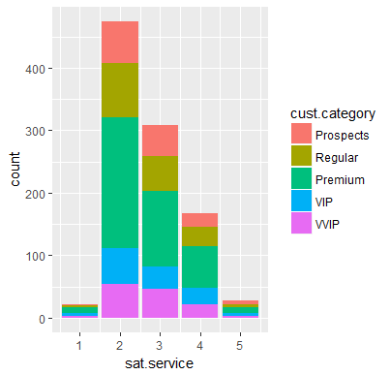
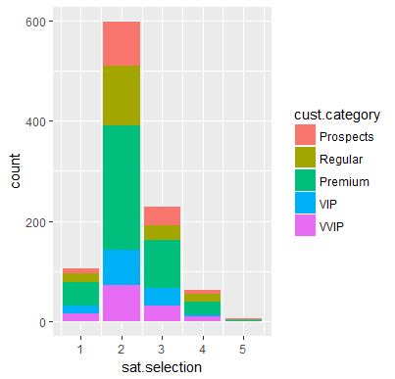
Satisfaction Rating Distribution
Service Satisfaction
Selection Satisfaction

Slide 7
Satisfaction Rating Break Down as Per Customer Category
Service Satisfaction
Selection Satisfaction
Rating | 1 | 2 | 3 | 4 | 5
Prospects | 1 % | 46% | 34% | 15% | 4%
Regular | 1 % | 48% | 31% | 16% | 3%
Premium | 2 % | 50 % | 29 % | 16% | 3%
VIP | 3 % | 41% | 28% | 20% | 4%
VVIP | 2% | 42% | 36% | 16% | 2%
Rating | 1 | 2 | 3 | 4 | 5
Prospects | 7% | 59% | 26% | 6% | 1%
Regular | 9% | 67% | 16% | 7% | 1%
Premium | 11% | 60% | 23% | 6% | 0%
VIP | 13% | 55% | 28% | 3% | 15%
VVIP | 12% | 55% | 25% | 8% | 0%

Slide 8
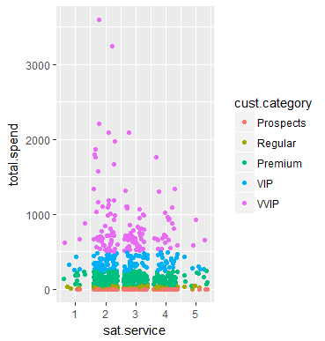
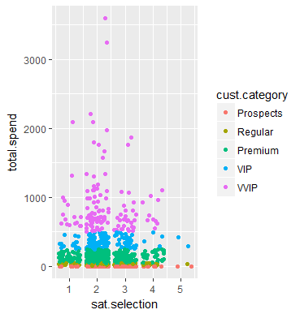
Total Spending & Satisfaction Rating
Observation
satisfaction service
Most of our loyal customers rate the service as poor, average or good.
Very few customers have voted service as very(rated 1) poor or excellent(rated 5)
Majority of the VIP and VVIP customers rate the service as poor to average
satisfaction selection
Shows poor rating percentage compare to service
Sizeable number of premium/VIP/VVIP have voted the selection as one and very few are fully satisfied(rated 5).
Majority of Premium/VIP and VVIP rate the service as very poor to average
Service Satisfaction
Selection Satisfaction

Slide 9
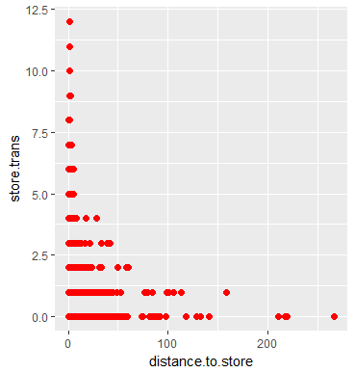
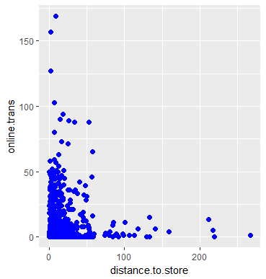
How Distance to Store Affect Store and Online Sell ?
Distance and Online Transactions
Distance and Store Transactions
Observation
Customer living closure to store are more likely
to shop at store than those who live 50 miles away.
Customers living within 50 miles of store are most
likely to make a purchase.
Dense online transaction graph shows that whether a customer lives close or far from store he/she is most likely to purchase online than go to store
Distance Range: 0 - 275miles
Store Transaction Range: 0 – 12
Distance Range: 0 - 275miles
Store Transaction Range: 0 – 167

Slide 10

Key Findings
Meet the Customer
Young adults majority of whom belong to (25-45 years) age group but overall range from 18 to 55 years.
Prefer online shopping as 78% shop online and only 22% in-store.
Mostly financially stable, credit score range from (600-950)
71% of our total customers return to shop. While 85% of total online customers return and 55% first time store buyers return to store
Customer have significantly higher number of transactions online(169) compare to store(12)
and spend a lot more online in a single purchase($3593) as oppose to store purchase(706).

Slide 11
Levels of Customer Satisfaction
Happy customers make successful business but analysis of the customer feedback in the dataset shows that most customer are neither satisfied with service nor selection.
Service and Selection both have opportunities for enhancements, but selection is rated lower than service and may need extra attention.
Utilization of Customer Segmentation
Based on the average total spending amount we divided our customers in to a group of five. (Prospects, Regular, Premium, VIP, VVIP).
With the precise target group in mind marketing, sales and customer communication teams of the business can develop unique communication tools and strategies to lure new customers and retain our most valuable loyal base.

Slide 12

Proposals for Further Usage of This Analysis
Dig deeper into customer segmentation by pairing the available analysis with purchase time frame to identify discount lovers, loyal and impulsive buyers.
Analyze product performance by mapping the satisfaction rating break down to
individual product and it’s category.
Predict product preference of customers and offer suggestions by mapping customer’s to the purchased and browsed products.

